Slide 1
Indianapolis Recommander system
Bin Peng
IUPUI computer science

Slide 2
What can the system do?
This is a system that can recommend the event that is going to happen, the movie in the theatre, the food and landmarks in Indianapolis to people and let them have a good view of this wonderful city

Slide 3
Why do you want to use it?
Most people are lazy and have difficulty in decide what to do.
So let the software decide for you!
Also can save you time by opening four kind of software or search for a long time in the sea of google!

Slide 4
About the software
This software is written in Python
The GUI of it is using the TkInter package
The data processing module is using BeautifulSoup4
Package also use: os, PIL, Image, string

Slide 5
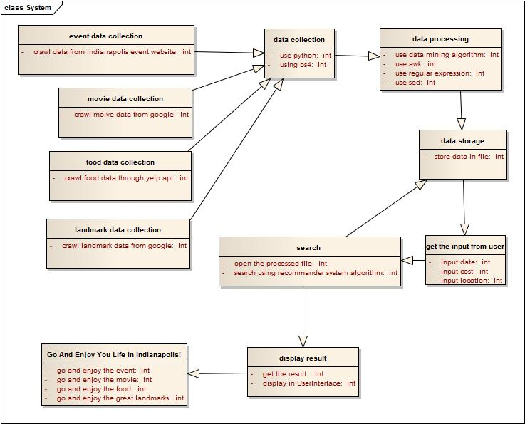

Slide 6
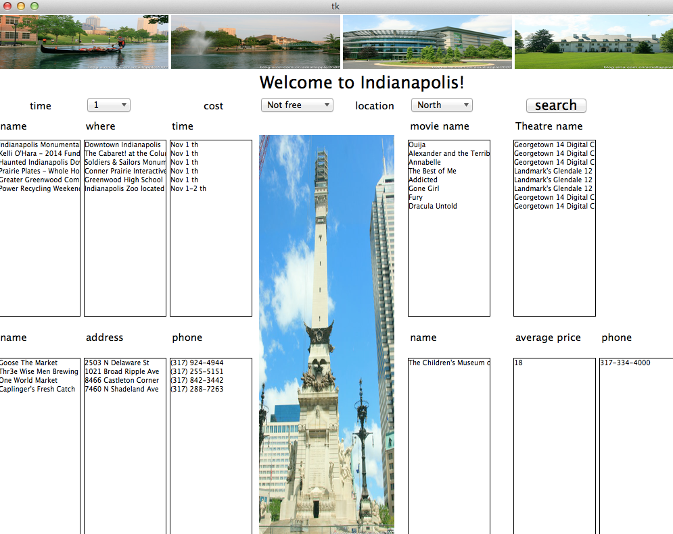
Screenshot of the UI

Slide 7
How I get the data?
My data source is google, yelp, IndyEvent.
First, I will google the page of the event, the movie, the food and the landmark in the indianapolis.
Then, I will download the html page which contain the information I need.

Slide 8
How I recommend?
The recommender algorithm is based on
where you want to go.
When you want to go.
Whether you want to spend money.

Slide 9
Show time~
https://www.youtube.com/watch?v=VPxETch-FlI

Slide 10
You know what?
This is not the end~
What just shown is just a simple python PC program

Slide 11
A Website App
This website can be viewed in a browser from PC or laptop, an iphone, an android phone, an windows phone.
Almost every phone that have a browser can use it.

Slide 12
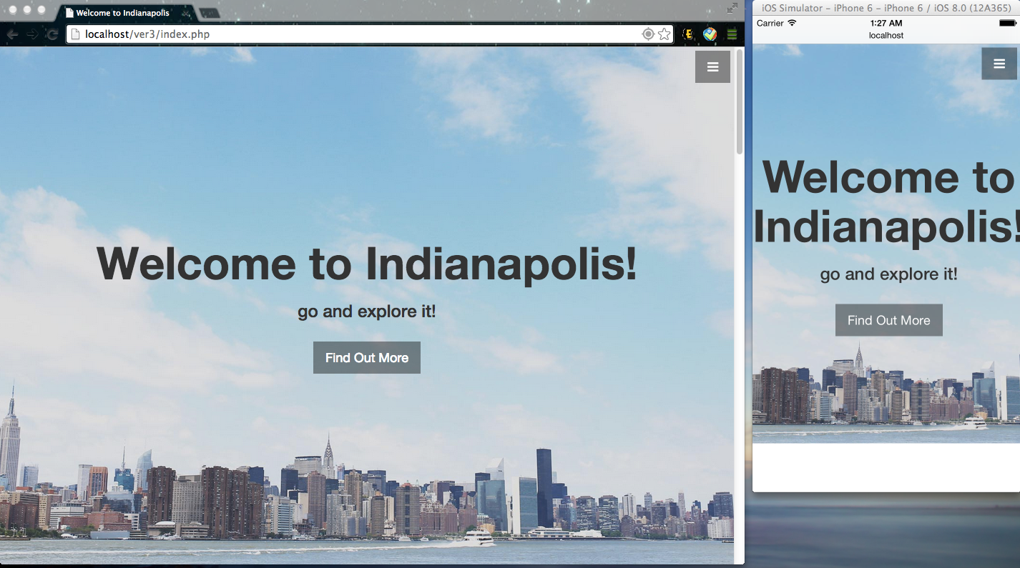
What’s the difference?

Slide 13
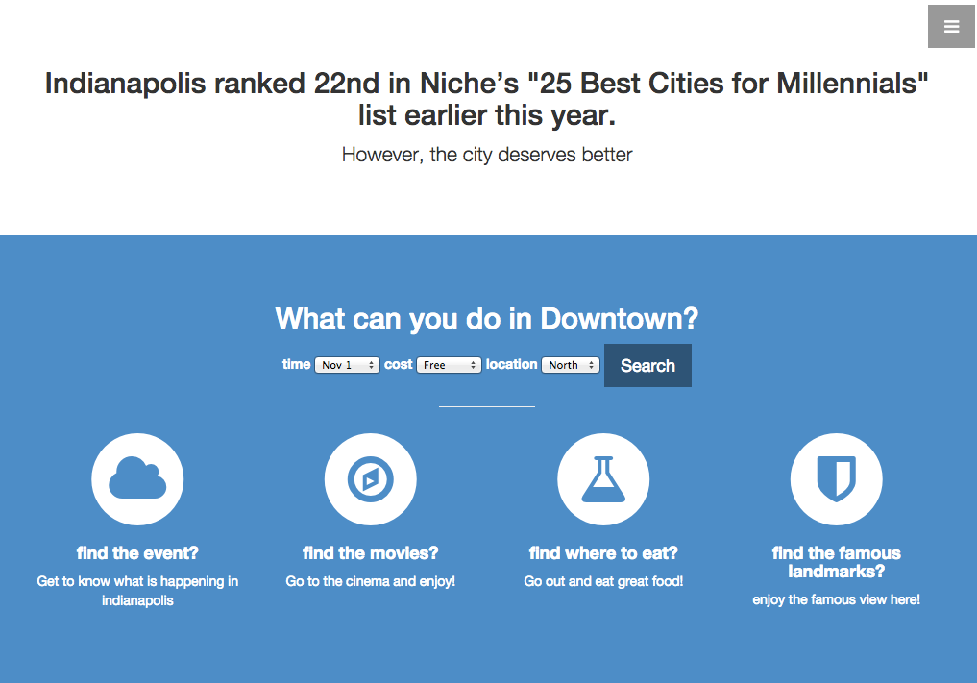

Slide 14
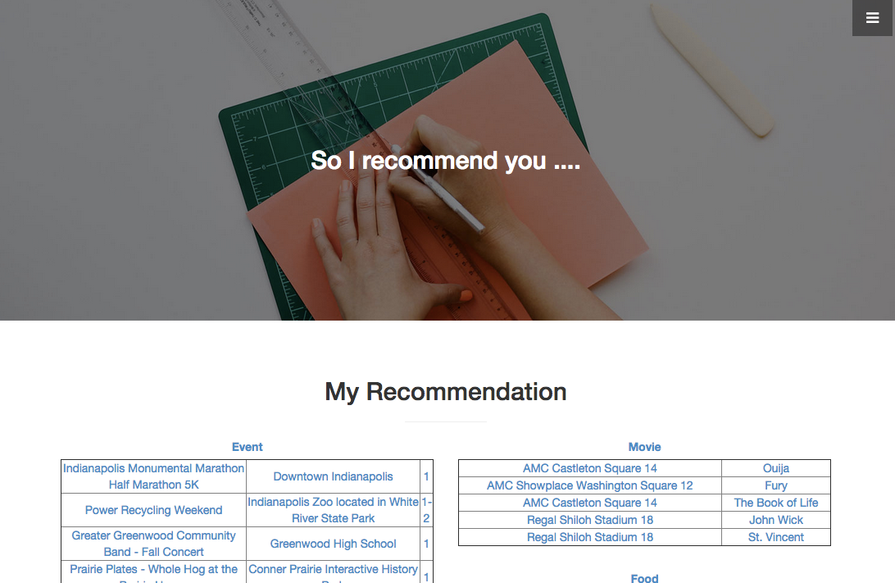

Slide 15
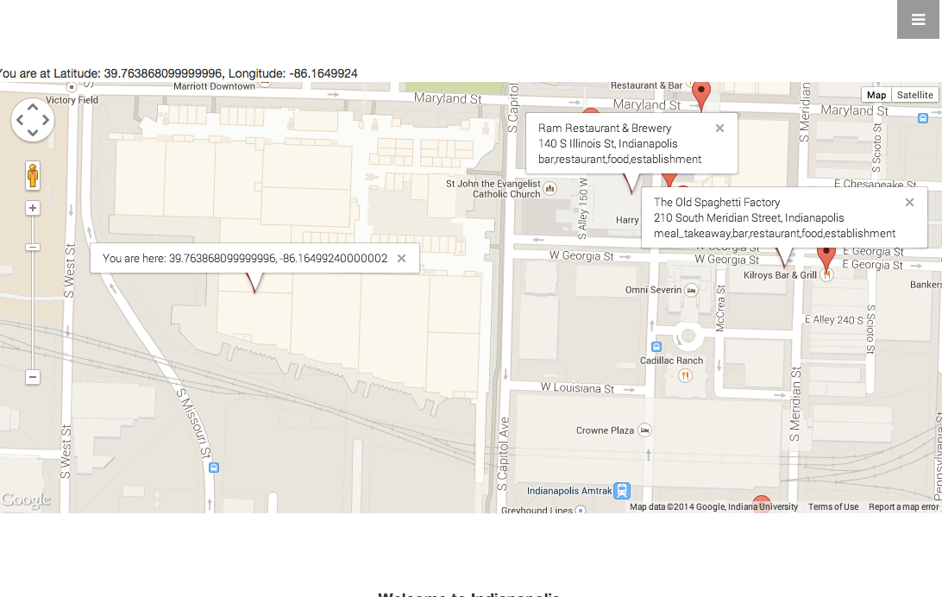

Slide 16
Show time~

Slide 17
Thank you For your listening!

